Slide 1
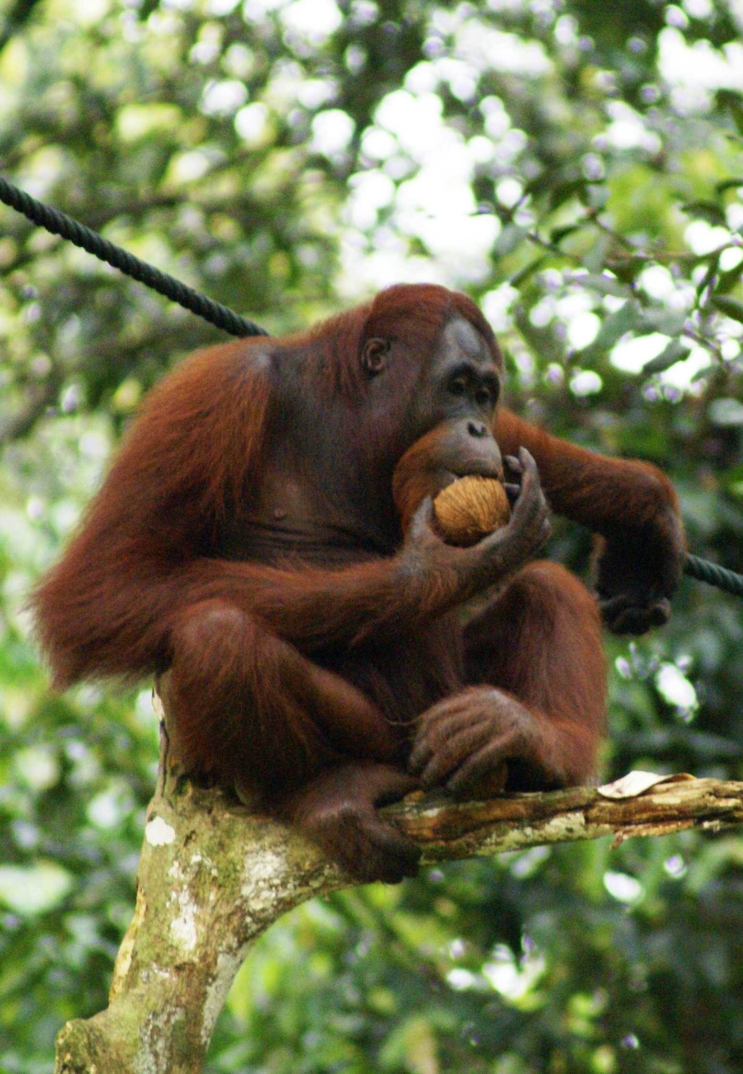
Second Methods lecture
Alternative ways to estimate abundance
Survey design
Alternative methods to estimate abundance
When estimating abundance goes wrong
Ways to estimate survival of individuals
Open CMR theory and stats
Open CMR case study

Slide 2
Key component of science
Make a prediction(s) based on a hypothesis or model
Take observations suited for testing hypothesis
Compare your prediction with your observations
Does your prediction match your observations?
Allows you to test a single hypothesis
Compare your predictions with your observations
Which predictions correspond to your observations?
Discriminate between observations and multiple hypotheses

Slide 3
The Popperian scientific process
Ecological hypothesis
Predictions
Suite of models
Target population
Study design
Collect data
Statistical models
Retain/reject hypothesis
Note that many do not subscribe to a Popperian view of science, myself included.

Slide 4
Strong inference is crucial
Different studies have different strength of inference
Best case is experimental analysis
Does increasing temperature reduce fecundity?
Do it in a lab and find out
“Worst” case is observational studies
Very high risk of spurious correlations
Encourages a posteriori explanations (“harking”)
We weren’t expecting this result. How do we make sense of it?
Strong
Manipulative experiments
Strength of inference
Structured design studies
Observation studies - a priori hypotheses (before you begin) - a posteriori hypotheses (after you finish)
Weak

Slide 5
Suitable inference requires suitable monitoring
“Survey and monitoring form the bedrock for conservation. Without knowledge of the distribution and size of populations and how they are changing, the actions of conservationists must necessarily be based upon hunches and intuition that have a high chance of failing the species or habitats they wish to conserve.
- BTO
“Monitoring of populations is politically attractive but ecologically banal unless it is coupled with experimental work to understand the mechanisms behind system changes.”
- Krebs
“Millions of dollars are currently being wasted on monitoring programmes that have no realistic chance of detecting changes in the variables of interest.”
- Lindenmayer

Slide 6
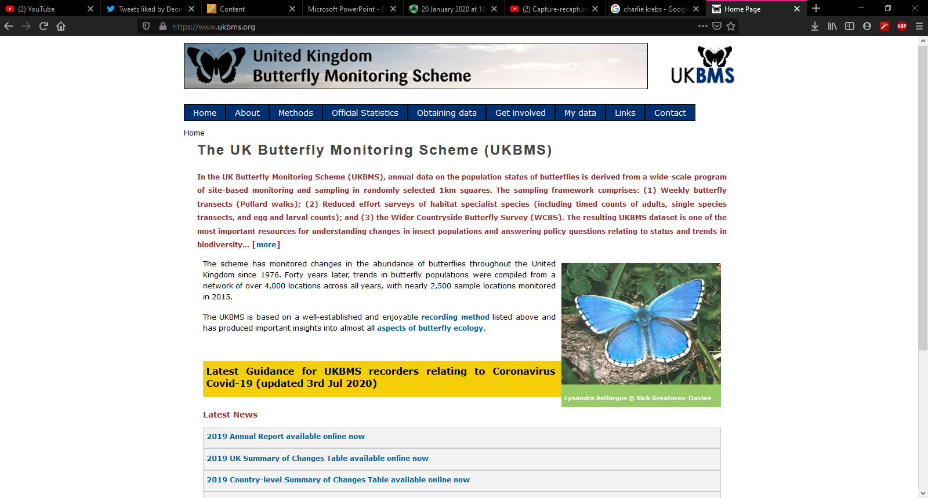
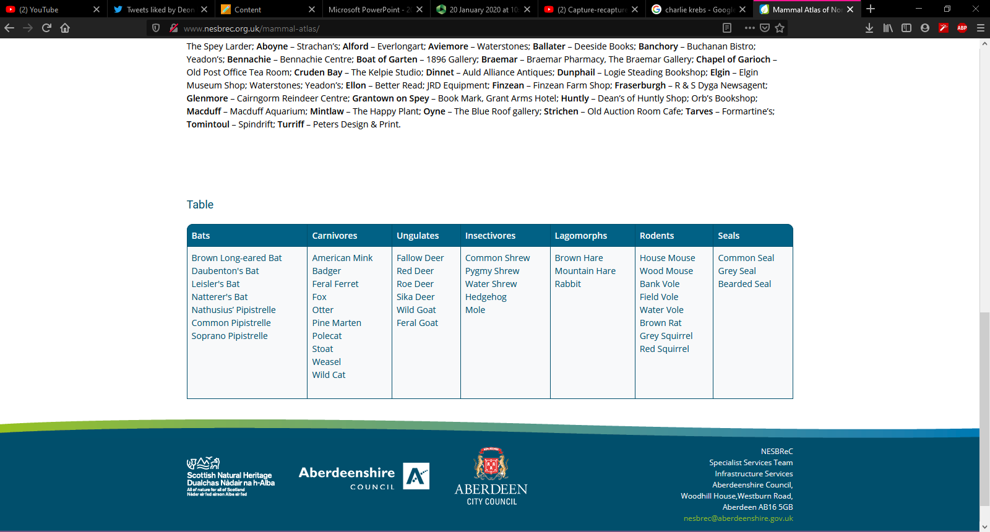
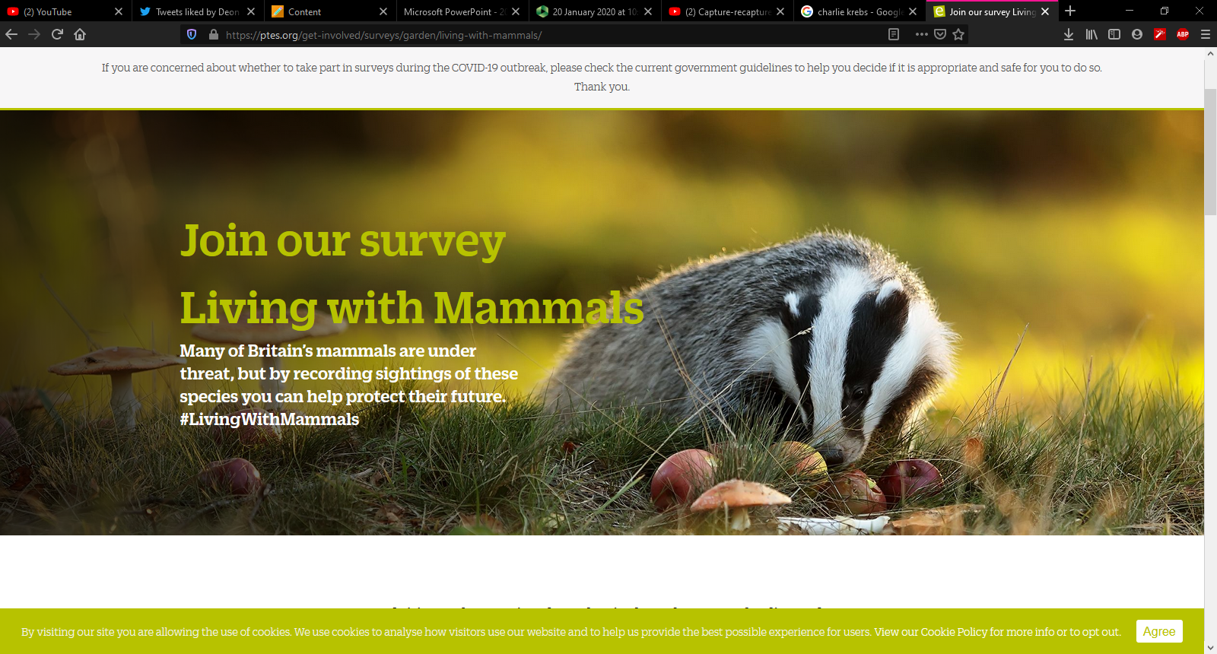
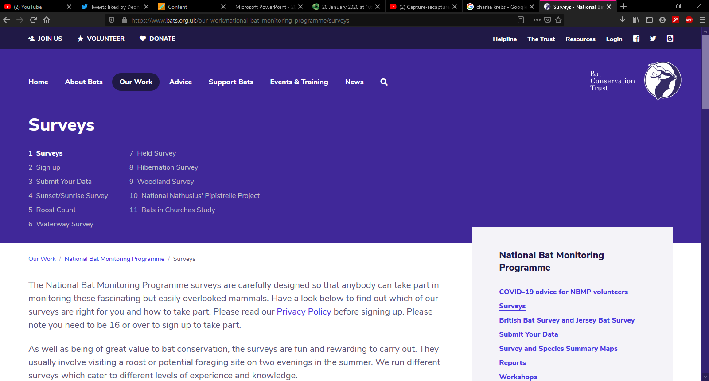
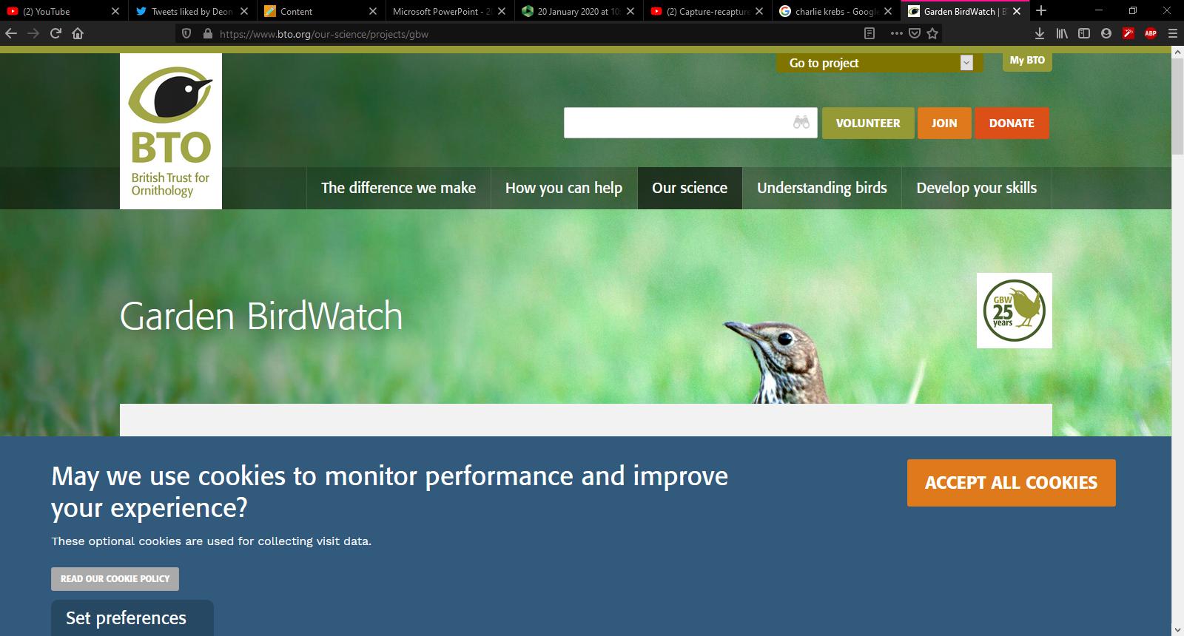
Monitoring of populations is politically attractive but ecologically banal

Slide 7
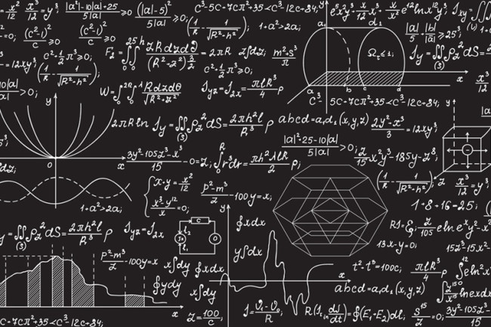
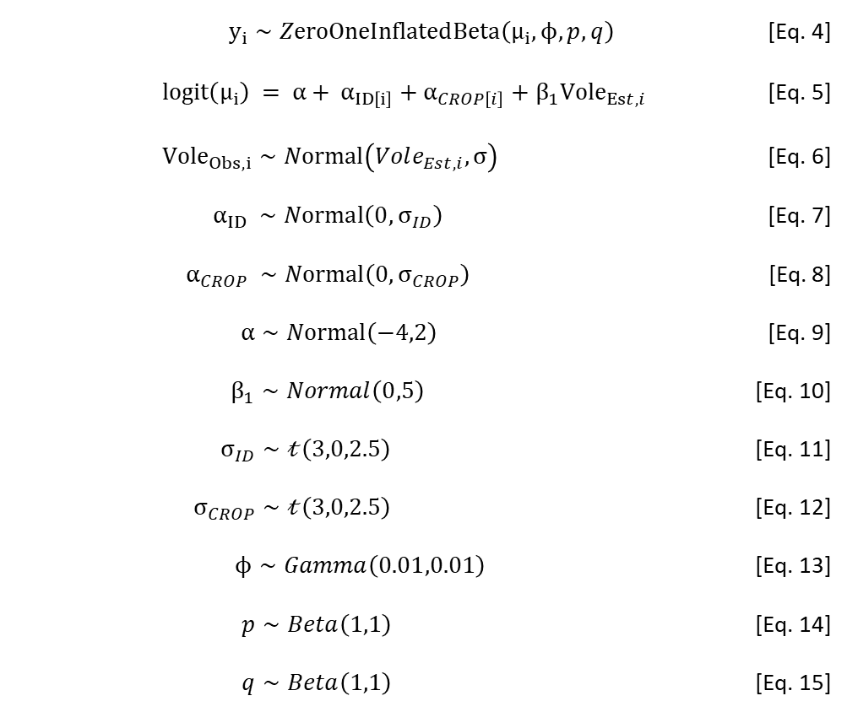
Such monitoring schemes can technically be used
But at huge cost and high chance of it still ending up being uninformative
$y_{i}∼ZeroOneInflatedBeta\left(μ_{i},ϕ,p,q\right)$ [Eq. 4]
$logit\left(μ_{i}\right) = α+ α_{ID\left[i\right]}+α_{CROP\left[i\right]}+β_{1}Vole_{Est,i}$ [Eq. 5]
$Vole_{Obs,i}∼Normal\left(Vole_{Est,i},σ\right)$ [Eq. 6]
$α_{ID} ∼Normal\left(0,σ_{ID}\right)$ [Eq. 7]
$α_{CROP} ∼Normal\left(0,σ_{CROP}\right)$ [Eq. 8]
$α∼Normal\left(−4,2\right)$ [Eq. 9]
$β_{1}∼Normal\left(0,5\right)$ [Eq. 10]
$σ_{ID}∼𝓉\left(3,0,2.5\right)$ [Eq. 11]
$σ_{CROP}∼𝓉\left(3,0,2.5\right)$ [Eq. 12]
$ϕ∼Gamma\left(0.01,0.01\right)$ [Eq. 13]
$p∼Beta\left(1,1\right)$ [Eq. 14]
$q∼Beta\left(1,1\right)$ [Eq. 15]

Slide 8
Limited resources, lots of demands
“In times of limited conservation funding and almost unlimited conservation needs, efficient use of monitoring effort is vital for successful conservation.
[…]
we argue that monitoring should not be viewed as a stand alone activity but instead as a component of a larger process of either conservation-oriented science or management”
- Jim Nichols and Byron Williams (2006) Trends in Ecology and Evolution 21(12)

Slide 9
What’s missing from unstructured monitoring?
Lack a clear statement of goal, with statements such as;
“Additional information about the system will inherently be useful…”
No clear desire to gain a scientific understanding of what is driving the processes in the system to make any changes
No acknowledgement that a baseline, that can be used to measure potential changes in the system, is required
Gains or losses
Lack of appreciation that data can provide information useful for making informed management decisions!

Slide 10
Key elements for conservation/management
Define;
Objective(s)
What do you want to achieve?
Alternative management options
Stuff that you can do
Model the system response to management actions
To help inform future management
Measures of model uncertainty
Monitoring program to estimate the state of the system and any other relevant variables

Slide 11
Useful management objectives
Articulate the desired outcome over a specific time frame
Maximise harvest over 100 years
Maintain N > 1000 for minimal cost over 20 years
Maximise population size with minimal damage to farming interests
Objectives may include both conservation and socio-economic goals
Trend detection per se is not a useful management objective
Just wanting to detect what the trend is, is not enough
Must come with some justification and understanding of how result will impact management
Monitoring is NOT managing

Slide 12
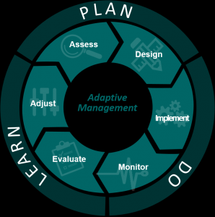
Adaptive management
Is there a problem?
Monitoring & analysis
What’s the problem?
E.g. Survival, reproduction, etc.
What’s causing the problem?
Covariates
What are your options?
Matrix modelling
Are the options acceptable?
Public opinion, logistically feasible?
Has management been effective?
Monitoring
Should anything change?
Adaptive management

Slide 13
Two types of monitoring
Surveillance monitoring
Simply about collecting data
Not guided by a priori hypotheses and corresponding models
Targeted monitoring
Integrated into a management plan
Monitoring design and implementation based on a priori hypotheses and corresponding models
Intended to see determine the outcome of management interventions

Slide 14
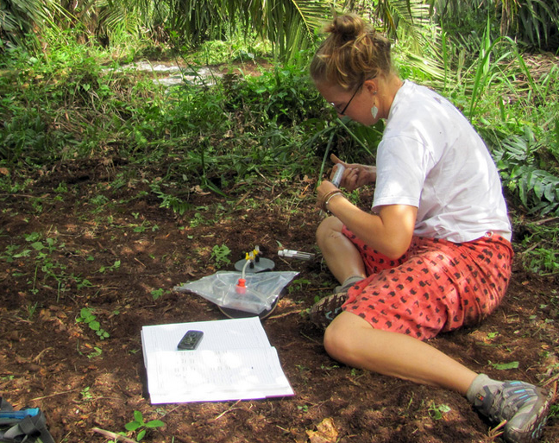
Survey design
Designing surveys suitable for making inference

Slide 15
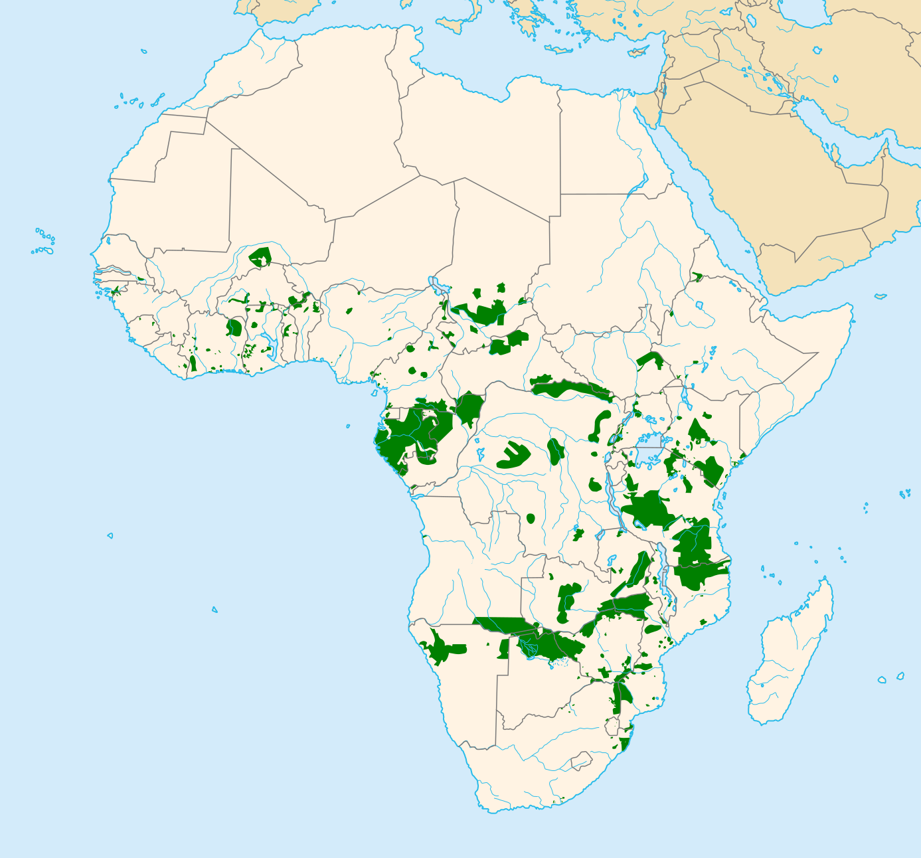
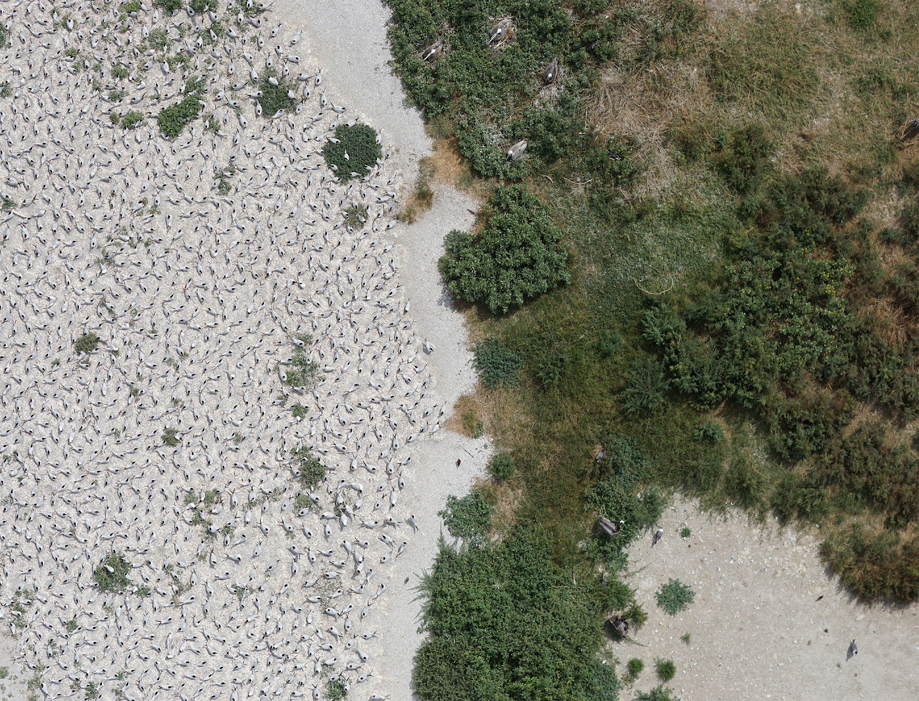
Designing a sample survey
Target population
The population you want to sample from and draw inferences about
Sample population
The portion of the population that you are able to sample
You can make legitimate statistical inferences only about the sample population
If you want to make inferences about target population, make sure sample population is representative

Slide 16
How much do we need to sample?
State how many individuals you need for sample to be representative
Often lacking in monitoring schemes (see Yoccoz et al. 2001)
How much imprecision can be tolerated in the parameter estimates?
“Want to be able to detect an increase of 1% in mortality rate when American mink are present”
Simulations are insanely powerful tool for determining this
Sometimes called “power analysis”

Slide 17
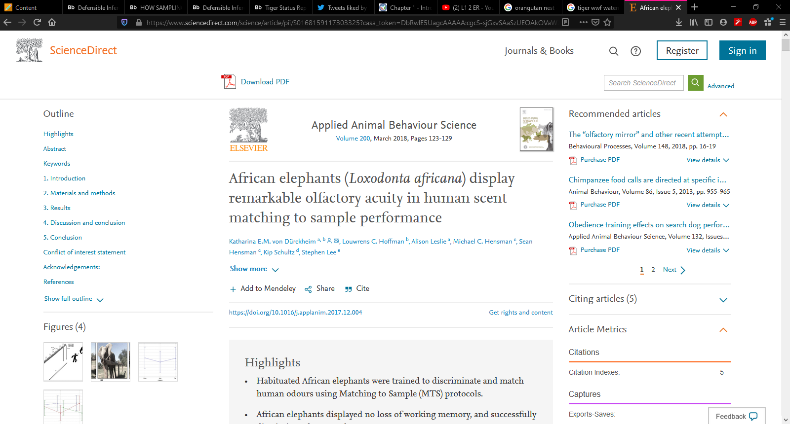
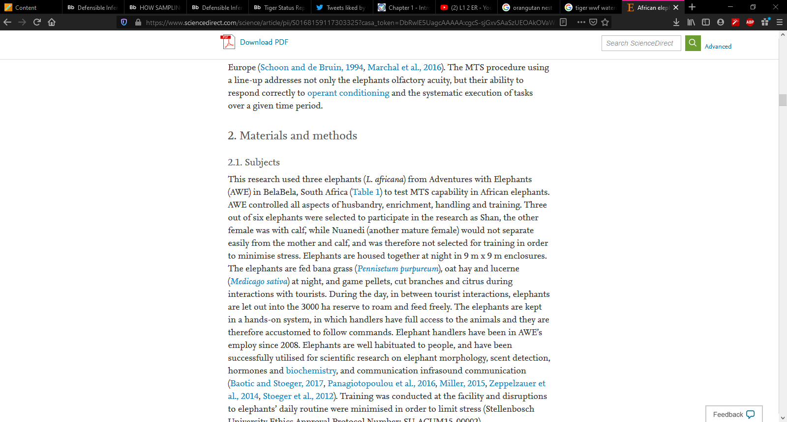
You can only make inference about the sampled population
You need mountains of data for to even consider making inferences about the wider population
Would you trust someone who measured the height of three people, who then used this to tell you the average height of all humans?

Slide 18
Selecting sampling units
Simple random sampling
Best approach, so long as all animals have same probability of being sampled
Systematic sampling
Satisfactory only if all members of a population are distributed at random
Clustering causes issues with this approach
E.g., sample every 10 meters
Key aspect is which of these will allow you to make inferences about the sampled population.

Slide 19
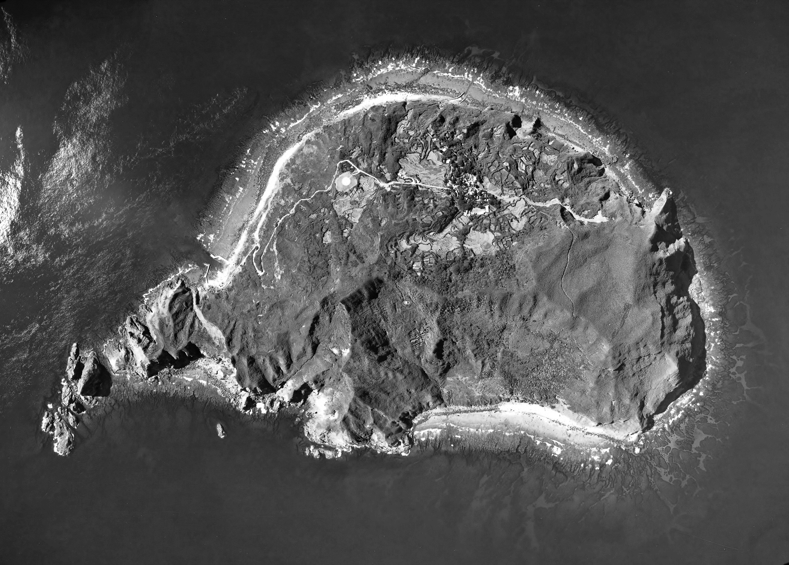
Random sampling
From a statistical point of view, truly random sampling often best
Truly doing random sampling can be difficult
“Haphazardly sampled” is what most people do

Slide 20
Stratified sampling
Dividing sampling into identifiable habitat (strata) types
Reduces variance
Ensures representative coverage
Can provide estimates for each habitat

Slide 21
Proportional and optimal allocation
Proportional
Sample size split for each strata, according to their fraction
Optimal
Sample size split according to which strata will have most variance
Plus many other types

Slide 22
tl;dr
Monitoring is crucial for conservation and management
But is not the end goal
Must be part of a wider plan for it to be of any use
Care and thought must be given to what level you can make inferences at
In almost all cases, limited to sample population
But you are free to speculate and very cautiously suggest wider inferences
The best form of monitoring is when there is an appropriate design to the data collection
Different forms of sampling design that improve your ability to make inferences

